Slide 1
World Class Leadership
Sarah Alhussain

Slide 2
Quote
“Your leadership is an extension of the relationship with yourself”
Michael Anderson

Slide 3
Leadership Mindset Scorecard
People’s perception (16/40)
Strategic Mindset (27/40)
Strategic Leadership (13/40)
Inner World (13/40)
Team Leader (30/40)

Slide 4
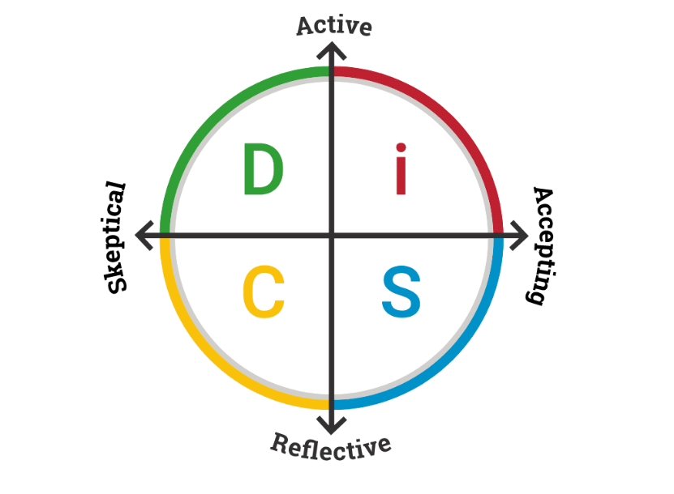
DiSC Assessment Profile
Stability
SC styles thrive in safe, predictable environments.
They enjoy working steadily toward a goal.
They tend to follow reliable, well-established procedures.
Support
Find fulfillment in supporting others who are facing challenges.
Enjoy working behind the scenes rather than having the pressure of the spotlight.
They like being part of a larger group effort.
Accuracy
SC-type people tend to prioritize accuracy more than other S styles.
They like catching errors, bringing organization to a project, and working with precision.
They take pride in maintaining high standards for the quality of their work.

Slide 5
The ARC Process
Awareness
Response
Compassion
Be aware of the situation, pause, and get curious.
Take a moment to think and formulate a response – DON’T react instinctively or emotionally to the situation.
Consider the questions why did this happen? And how can we solve it in a way that will benefit all parties involved?

Slide 6
Arrogance
Form of insecurity
Ego goes on the offensive
Pushes people away
Confidence
From people secure with themselves
People are drawn to confidence
Results in loyalty, respect, & inspiration
Assertiveness
Shyness
Form of insecurity
Ego trying to hide
Never leaves comfort zone

Slide 7
Leadership Setbacks – Imposter Syndrome
It is a psychological pattern where individuals doubt their accomplishments and fear being exposed as a "fraud," despite evident success and qualifications.

Slide 8
Effects of Imposter Syndrome on Leadership
Undermined Confidence: Lack of self-confidence, preventing the pursuit of leadership roles or positions.
Fear of Failure: Fear of being exposed as incompetent can lead to risk-averse behavior, stifling innovation and the ability to make decisive actions required of leaders.
Reluctance to Seek Opportunities: Hesitant to apply for promotions, volunteer for leadership projects, or take on challenging tasks.
Overworking: To compensate for perceived inadequacies leading to burnout.
Avoidance of Visibility: Avoid increased visibility, such as public speaking or high-profile projects, which are often critical for leadership roles.
Difficulty in Delegation: Trusting others and delegating tasks can be difficult leading to micromanagement and inefficiencies.
Impact on Decision Making: Second-guessing and overanalyzing decisions reduces the ability to act swiftly and confidently.
Strain on Relationships: Stress and anxiety affect interpersonal relationships within a team, hindering collaboration.

Slide 9
Strategies to Overcome Imposter Syndrome
Acknowledge and Normalize Feelings: Recognize that imposter syndrome is common, and many leaders experience these feelings.
Seek Feedback and Mentorship: Provides reassurance and a more accurate perspective on abilities and accomplishments.
Celebrate Achievements: Helps reinforce self-worth and build confidence.
Develop Self-Awareness: Understanding strengths and areas for growth
Reframe Negative Thoughts: Replace with positive affirmations and evidence of past successes.
Set Realistic Goals: Builds confidence and reduces the fear of failure.
Seek Professional Help: Therapy or coaching can be beneficial in addressing deep-seated issues related to imposter syndrome.

Slide 10
Leadership Styles
Leadership style - the behavior pattern of an individual who attempts to influence others. It includes both: 
Directive (task) behaviors
Supportive (relationship) behaviors

Slide 11
My Leadership Style
Situational Leadership
Characteristics:
Adapts style based on the situation and team needs
Flexible and dynamic
Balances task orientation with relationship orientation
Can be directive or supportive as required
Effective in varied and changing environments

Slide 12
A Hero’s Journey Highlights
Transformation through Adversity
Self-awareness and Reflection:
Recognizing where you are, what challenges you face, and how you can grow from these experiences, you can navigate your path more effectively and align your actions with your personal and professional goals.
The Hero’s Journey emphasizes that significant personal and professional growth comes from overcoming challenges and facing one’s fears.

Slide 13
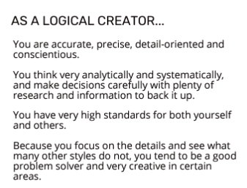
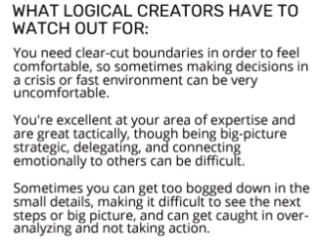
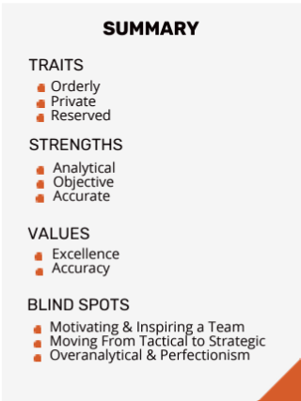
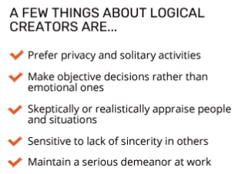
Growth Leadership Style – Logical Creator

Slide 14
Moving from Tactical to Strategic
Create Space
- Clear schedule of non-essential meetings and urgent tasks.
- Collaborate with the manager to plan for uninterrupted time.
- Use techniques like journaling or spending time in nature to refocus.
Build Knowledge
- Utilize organizational resources such as training or knowledge centers.
- Consult with subject matter experts.
- Expand learning through external sources like articles, podcasts, and unrelated topics.
Adopt a Growth Mindset
- Embrace the belief that strategic capacity can be developed over time.
- Address and overcome limiting beliefs about creativity and strategic thinking.
- Focus on learning and growing through challenges and experiences.

Slide 15
Important Points for Leaders from "A Survival Guide for Leaders"
Maintain Focus: Stay focused on the key issues and avoid getting sidetracked.
Regulate the Heat: Manage the stress level within the organization to keep it productive.
Anchor Yourself: Maintain a clear sense of your values and purpose.
Give Work Back to the People: Encourage others to take responsibility for tackling challenges.
Protect Your Leadership: Safeguard yourself against personal attacks and maintain your integrity.

Slide 16
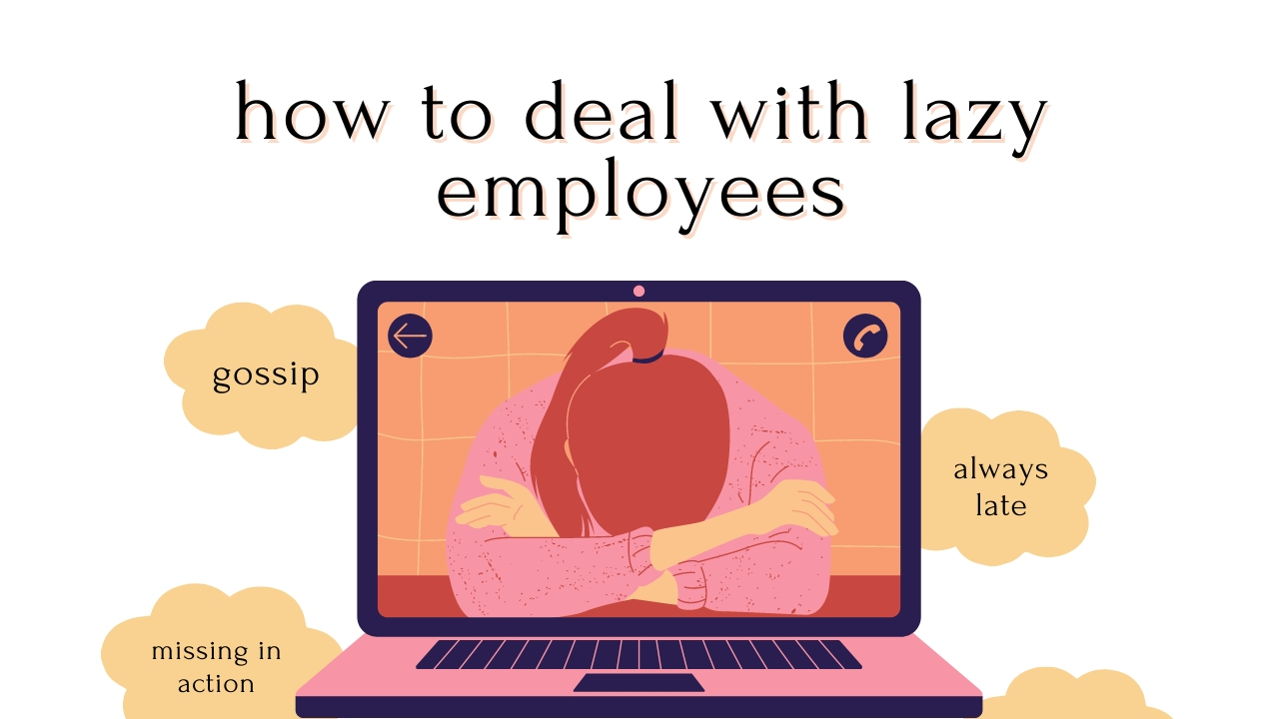
Leadership Challenges
Letting People Go the Right Way
Preparation: Gather all necessary documentation and ensure compliance with legal and organizational policies
Clarity and Compassion: Communicate the decision clearly and compassionately, explaining the reasons without ambiguity
Support and Transition: Provide support for the transition, including offering resources for finding new employment or counseling
Maintain Dignity: Treat the employee with respect.
**Effective handling of terminations minimizes negative impacts on the individual and the organization.

Slide 17
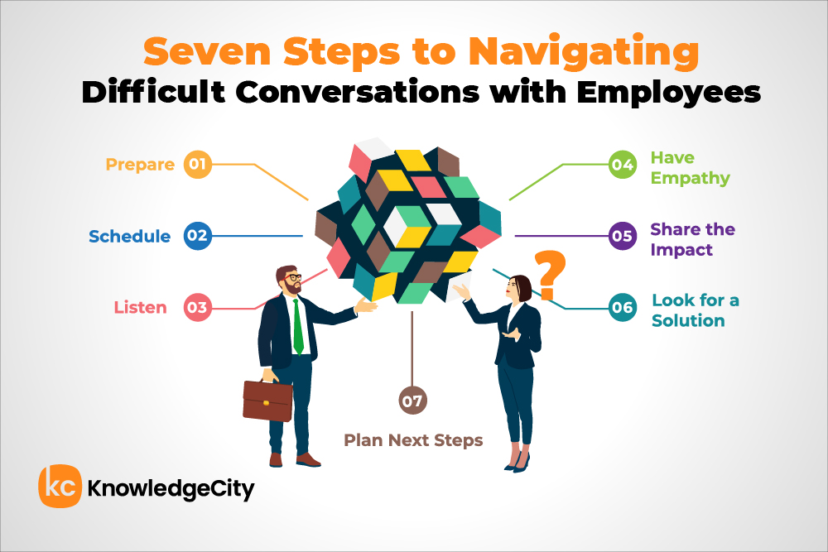
Leadership Challenges
Difficult Conversations
Leaders often face difficult conversations requiring tact, empathy, and effective communication skills.
Preparation: Plan the conversation, understanding the key points and potential responses.
Active Listening: Listen actively to understand the other person’s perspective and demonstrate empathy.
Clear Communication: Be clear and direct, avoiding misunderstandings while being respectful.
Stay Calm: Maintain composure, manage emotions, and create a safe environment for open dialogue.
** Navigating difficult conversations effectively strengthens relationships and fosters a positive organizational culture.

Slide 18
Inclusive Leadership
Inclusive leadership fosters a culture where diversity is valued and leveraged.
1. Enhanced Decision Making
2. Improved Problem Solving
3. Increased Employee Engagement
4. Broader Market Understanding

Slide 19
Leadership Ethics – Deontological Theories
Deontological ethics focuses on duties, principles, and rules as the basis for ethical decision-making in leadership.
Duty-Based Ethics: Adhere to moral obligations and responsibilities, regardless of consequences (Northouse, 2021).
Principles of Rights: Respect and protect the rights of individuals affected by their decisions and actions (Northouse, 2021).
Categorical Imperative: Act according to universal moral principles that apply to all individuals in similar situations (Northouse, 2021).
Application in Leadership
Deontological theories guide leaders to make decisions based on ethical principles and duties, ensuring consistency and fairness.

Slide 20
Types of Followers
Leader
Isolates
Bystanders
Participants
Activits
Diehards
Detached/Unaware
Observe/Don't Particpate
Actively Engage
Take Action
Deeply Devoted/Risk Life

Slide 21
Understanding Followers
Leaders need to understand their followers' levels of engagement and motivations to lead and influence them effectively.
Effective leadership involves directing followers and understanding and responding to their needs and behaviors.

Slide 22
Leadership Awareness and Action Plan
Vision
Become a situational leader who inspires and motivates others to achieve their full potential based on the situation at hand through adaptability, flexibility, and inspiration.
Leadership Statement
Effective leadership varies based on the situation and the development level of the team members. Leading with a strong ethical framework where duty and principles guide decisions and actions.
I aim to create an environment where team members feel empowered to take initiative and are confident in their abilities. I intend to employ the leadership mindset of assertiveness, ensuring clear communication and setting firm boundaries while being approachable and supportive.
Empower
Confident
Assertive

Slide 23
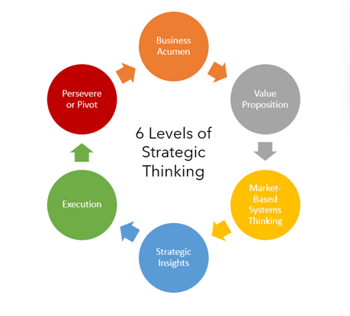
Leadership Awareness and Action Plan
Short-Term Goals – Take initiative
Long-Term Goal – Improve Strategic Thinking
Evaluation Method
Self-assessments.
Peer and Mentor Feedback.
Performance metrics
Action Steps
Enroll in a Leadership Development Program.
Attend a Strategic Leadership Workshop within the next year.
Mentor a Junior Team Member within the next few months.

Slide 24
References
Anderson, R. M. (2023). Leadership mindset 2.0: The psychology and neuroscience of reaching your full potential.
DiSC Profiles.com. (no date). What is the DiSC SC type? Retrieved from https://www.discprofiles.com/disc-sc-type/
Heifetz, R., & Linsky, M. (2002). A survival guide for leaders. Harvard Business Review, 80(6), 65-74.
Indeed Editorial Team. (2013). What is situational leadership? (4 styles and examples). Indeed.com
Kellerman, B. (2007). What every leader needs to know about followers. Harvard Business Review, 85(12), 84-91.
KnowledgeCity. (2023, July 8). A guide to having difficult conversations with employees. Retrieved from https://www.knowledgecity.com/blog/a-guide-to-having-difficult-conversations-with-employees/

Slide 25
References Con.
Northouse (2012). Leadership Theory and Practice. SAGE Publications, Inc. Sixth Edition.
Northouse, P. G. (2021). Leadership: Theory and Practice (6th ed.). Sage Publications
Penn State University. (2022, April 18). Inclusive leadership: The first steps to diversity. Retrieved from https://sites.psu.edu/leadership/2022/04/18/inclusive-leadership-the-first-steps-to-diversity/
Waresmith, T. (2021). 3 steps to move from tactical to strategic. LinkedIn. https://www.linkedin.com/pulse/3-steps-move-from-tactical-strategic-tess-waresmith-she-her-/

